Slide 1
ELIMINATION OF USELESS SYMBOLS
BY
NAVEEN ( RA2111026010082 )
SUDHARASHAN ( RA2111026010130 )
DEEKSHITH ( RA2111026010138 )
SUBJECT CODE :18CSC301T
SUBJECT NAME :Formal Language and Automata
FACULTY NAME :Mrs.J.Jeyasudha

Slide 2
OBJECTIVE OF A PROBLEM
The objective of the project is to develop a Graphical User Interface (GUI) tool that automates the process of eliminating unnecessary symbols in finite automata, specifically focusing on removing redundant states and transitions, in order to optimize the automaton while preserving its language recognition capabilities.
The project aims to create a robust, user-friendly GUI tool that empowers users to streamline automata representations, making them more manageable and comprehensible, and ultimately contributing to the advancement of automata theory and applications.
Develop algorithms and tools within the GUI to analyze finite automata, identifying symbols that do not contribute to the language recognized by the automaton. This analysis should cover a range of automata types, including deterministic and nondeterministic finite automata, regular expressions, and context-free grammars.
the project aims to create a robust, user-friendly GUI tool that empowers users to streamline automata representations, making them more manageable and comprehensible, and ultimately contributing to the advancement of automata theory and applications.

Slide 3
APPLICATION
Researchers in the field of automata theory, formal languages, and compiler design can use this tool to simplify automata representations, making their work more efficient. It aids in analyzing and optimizing automata structures in the context of research projects.
Automata are used in software development for tasks like lexical analysis, parsing, and code generation. Simplifying automata can lead to more efficient and faster software components. This tool can be used to optimize automata within compilers, interpreters, and regular expression engines.
Automata can be applied to network security for intrusion detection and firewall rule analysis. Simplifying automata can lead to more efficient and accurate security mechanisms, reducing false positives and false negatives.
the application of the project spans various fields, including education, research, software development, network security, hardware design, and many others. The ability to simplify automata using a user-friendly GUI can enhance the efficiency, performance, and comprehensibility of systems and applications that rely on automata theory and formal languages.

Slide 4
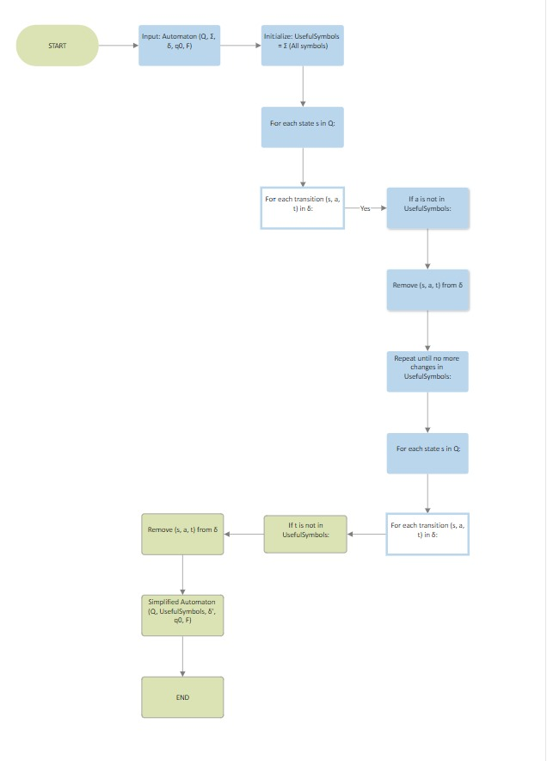
FLOW CHART

Slide 5
EXPLANATION
The software will internally analyze the provided automaton to identify symbols and transitions that are considered "useless." A symbol is considered useless if it doesn't affect the language recognized by the automaton. For example, if a symbol is never used in any valid path from the initial state to a final state, it is considered useless.
implement an algorithm to remove these useless symbols and transitions from the automaton while preserving the essential language recognition capabilities. The specific algorithm may vary depending on the type of automata
The GUI will provide visual feedback to the user, illustrating the changes made to the automaton as a result of symbol elimination. This could involve updating the automaton's diagram or providing a summary of the changes made.
The GUI will display the resulting simplified automaton, which is now free from useless symbols. Users can examine the simplified automaton and understand its structure and language recognition capabilities more easily.
Users can then apply the simplified automaton to various applications, depending on their specific needs, such as in education, research, software development, natural language processing, network security, hardware design, and more.

Slide 6
CONTRIBUTION
NAVEEN - Developed GUI
SUDHARASHAN - Developed code and generated the logic for the program
DEEKSHITH - Created the Power point

Slide 7
EXAMPLE PROBLEM
Let's consider an example problem that demonstrates the elimination of useless symbols in a finite automaton. In this problem, we have a finite automaton that recognizes a language defined by the regular expression:
(0+1)0(0+1)(0+1)
Here's the automaton:
States: q0, q1, q2 Alphabet: {0, 1} Transitions:
q0 --(0)--> q0
q0 --(1)--> q1
q1 --(0)--> q2
q1 --(1)--> q1
q2 --(0)--> q2
q2 --(1)--> q2
Initial State: q0 Final State: q2
Now, in this automaton, let's identify and eliminate the useless symbols and transitions. Useless symbols are those that do not contribute to recognizing any valid strings in the language. In this case, it's clear that the symbol '1' is useless because there are no valid transitions that involve '1’.

Slide 8
Elimination Process:
Identify Useless Symbols: The analysis identifies that '1' is a useless symbol.
Remove Transitions Involving '1': All transitions that involve the symbol '1' are removed. So, the transitions q0 --(1)--> q1 and q1 --(1)--> q1 are eliminated.
After the elimination process, the automaton becomes:
States: q0, q2
Alphabet: {0}
Transitions:
q0 --(0)--> q0
q2 --(0)--> q2
Initial State: q0
Final State: q2
The automaton has been simplified by eliminating the useless symbol '1' and the transitions involving '1'. This results in a more compact and efficient representation of the language it recognizes, which is (0+1)0(0+1)(0+1), where '1' is effectively removed from the language.

Slide 9
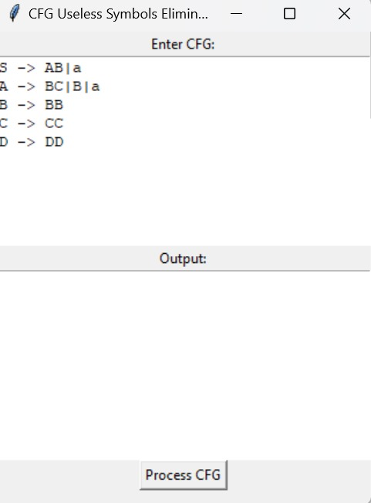
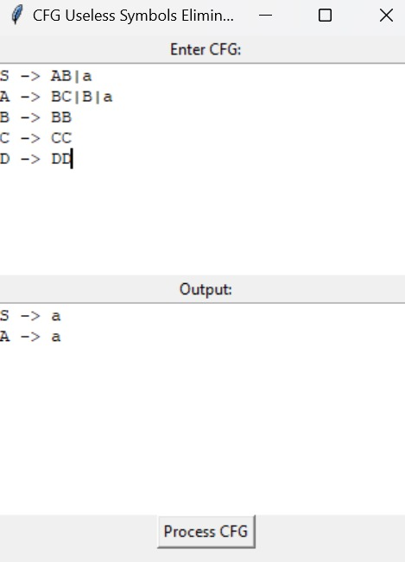
OUTPUT

Slide 10
CONCLUSION
this project has successfully delivered a Graphical User Interface (GUI) tool for the efficient simplification of finite automata by eliminating redundant symbols. This tool has the potential to greatly benefit a wide range of users, including students, researchers, and engineers, by making the process of automata simplification more accessible and user-friendly.
The project has met its objectives by providing a user-friendly interface that allows users to interact with automata visually. It also offers automated algorithms for analyzing automata and removing unnecessary symbols, while preserving the essential language recognition capabilities of the automata.
In summary, this project contributes to the field of automata theory by offering a practical, user-friendly, and efficient tool for automata simplification. By providing the means to eliminate useless symbols and simplify automata, this tool can help researchers, educators, and practitioners in various fields make more effective use of automata in their work.

